Slide 1
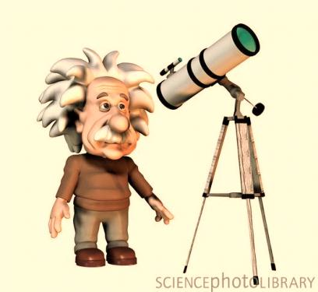
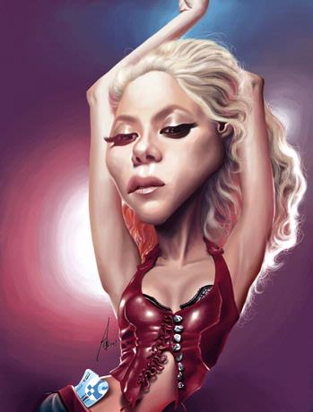
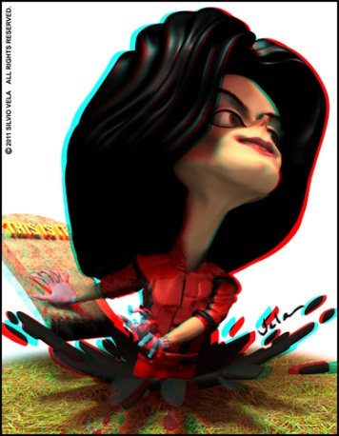
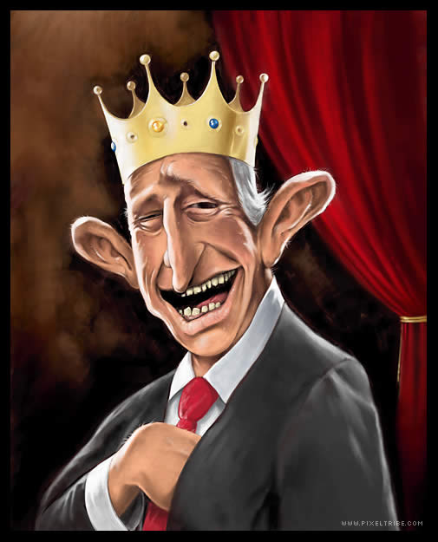
Famous People

Slide 2
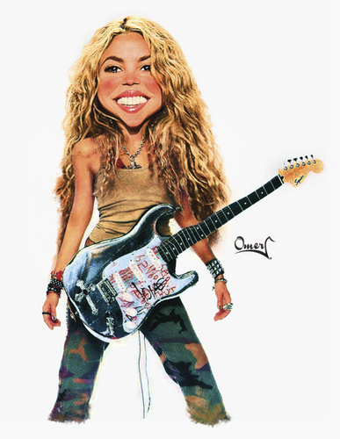
Her name is Shakira
She is from Colombia.
She is Colombian.
She is a singer.

Slide 3
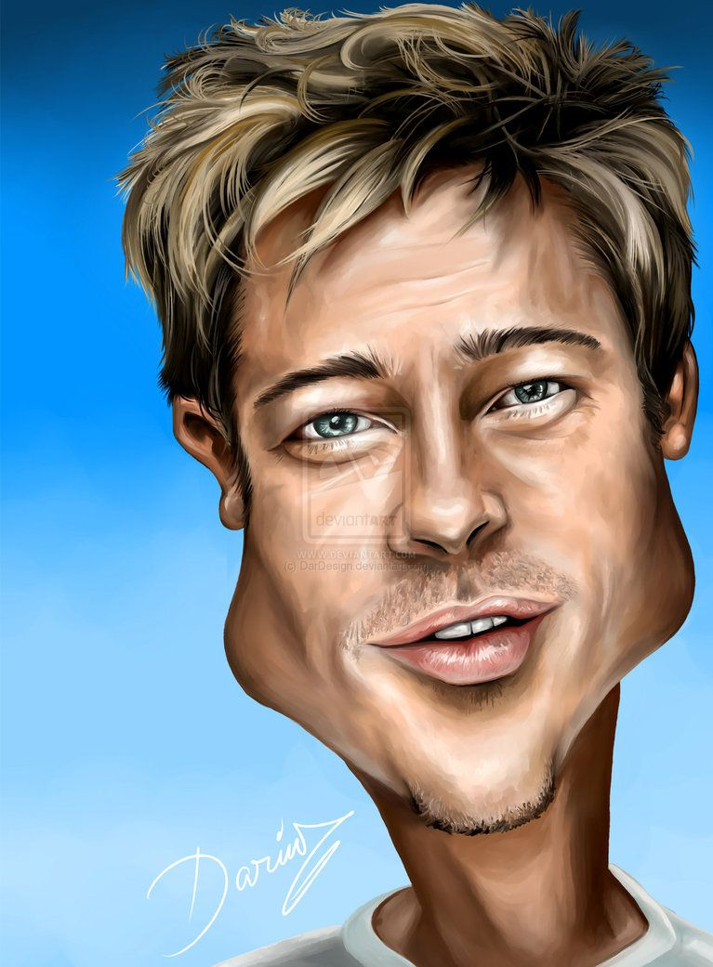
His name is Brad Pitt.
He is from The United States.
He is American.
He is an actor.

Slide 4
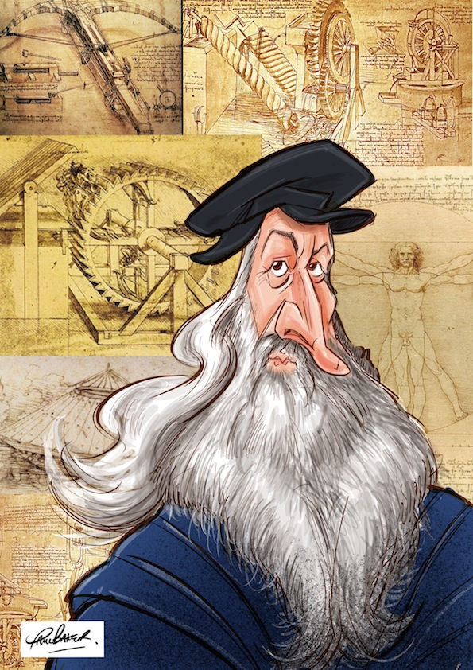
He is Leonardo Da Vinci.
He is from Italy.
He is Italian.
He is an artist.

Slide 5
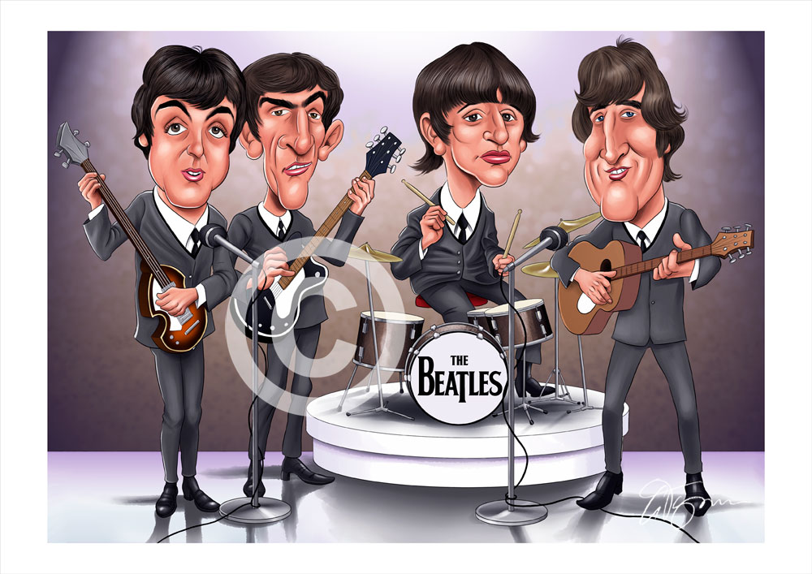
They are The Beatles
They’re from The United Kingdom.
They’re British
They’re musicians.

Slide 6
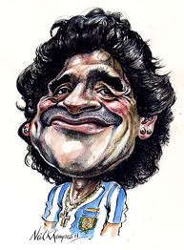
His name is Diego Maradona.
He is from Argentina.
He is Argentinian.
He is a soccer player.

Slide 7
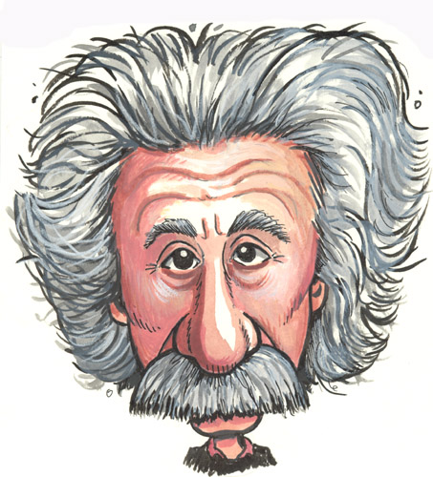
He is Albert Einstein.
He is from Germany.
He is German.
He is a scientist.

